Slide 1
AIRLINES PERFORMANCE ANALYSIS
PREPARED BY
S NIRMAL & ANURAG RAJAN

Slide 2
ABSTRACT
Airline performance analysis is essential for improving customer satisfaction and operational efficiency in the aviation sector. This project aims to predict the best-performing airlines in India by considering factors such as air time, ticket cost, customer reviews and feedback, quality of services, flight maintenance, and accident history. The central focus is to identify the airline with the highest level of customer satisfaction. Datasets are sourced from Kaggle and GitHub, combining structured flight data with unstructured customer sentiment. The methodology involves data preprocessing, exploratory analysis, machine learning prediction models, and visualization of performance metrics. Natural Language Processing (NLP) techniques are applied to analyze customer reviews, while statistical and predictive models assess safety and operational parameters . The project is implemented using Python, R, and SQL with libraries and tools such as Pandas, NumPy, Scikit-learn, NLTK, TensorFlow. The outcome is a data-driven framework to rank airlines by overall performance and customer satisfaction, providing insights for passengers and stakeholders.

Slide 3
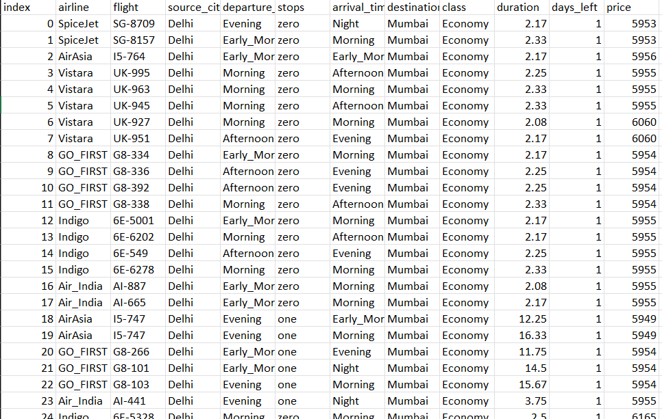
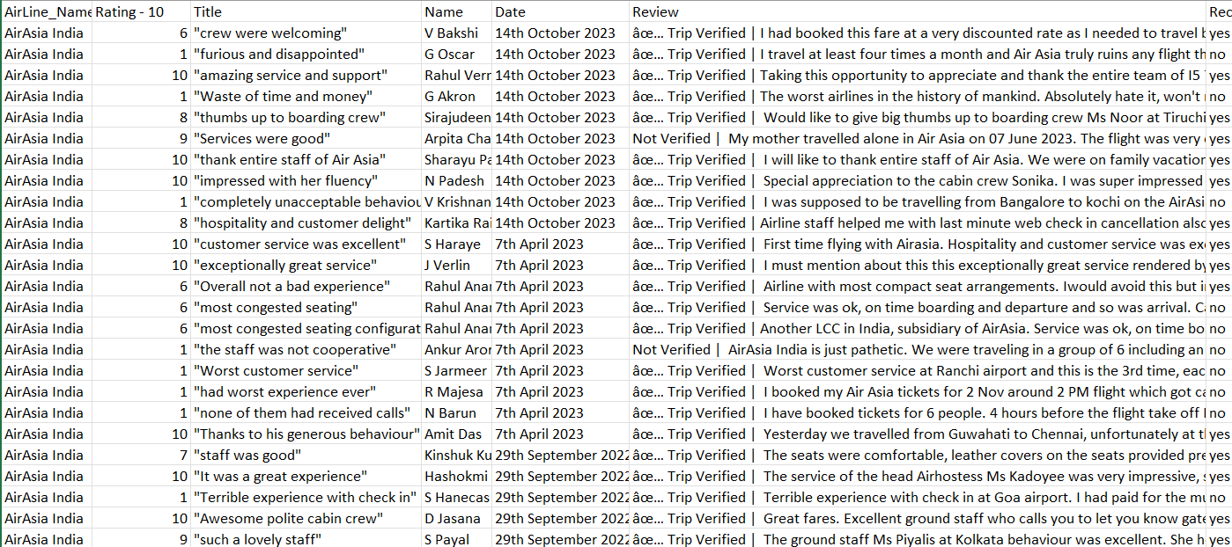
KAGGLE DATASET
GITHUB DATASET

